Slide 1
VIRTUSA COMPANY

Slide 2
PROJECT-1 Internal job portal Presented by: Harish Hruday Jeevana Kalyani Sathish

Slide 3
INTRODUCTION
Internal Job Portal Websites are designed to allow employers to post job requirements for a position to be filled and for jobseekers to find jobs according to their qualifications.
Advantages : Easy access to information , Speedy response by applicants.
Disadvantages : It involves time, Finances.
List of job portals : NAUKRI,
MONSTER,
CAREER JET etc.

Slide 4
1.Class Diagram 2.Use Case Diagram 3.Activity Diagram 4.ER Diagram

Slide 5
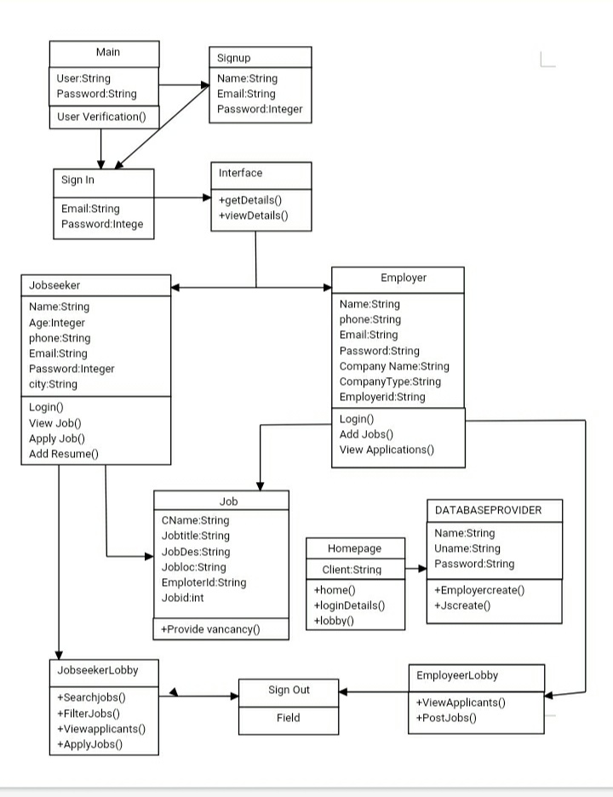
1.Class Diagram

Slide 6
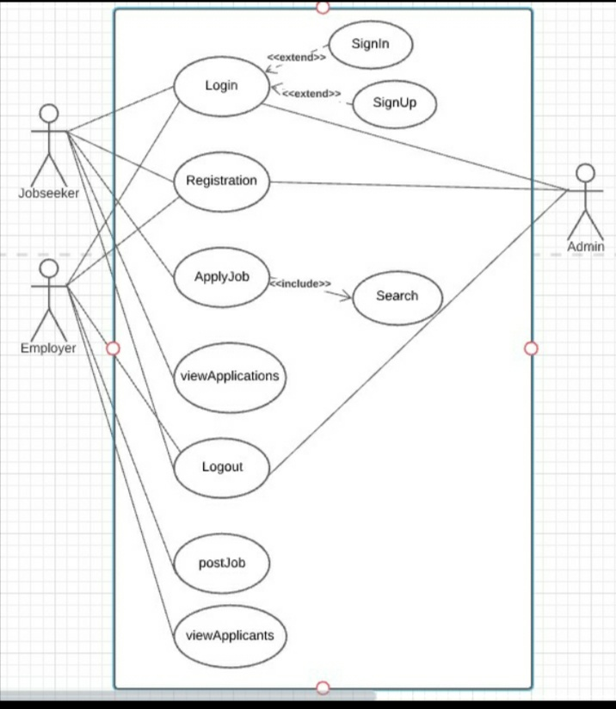
2.UseCase Diagram

Slide 7
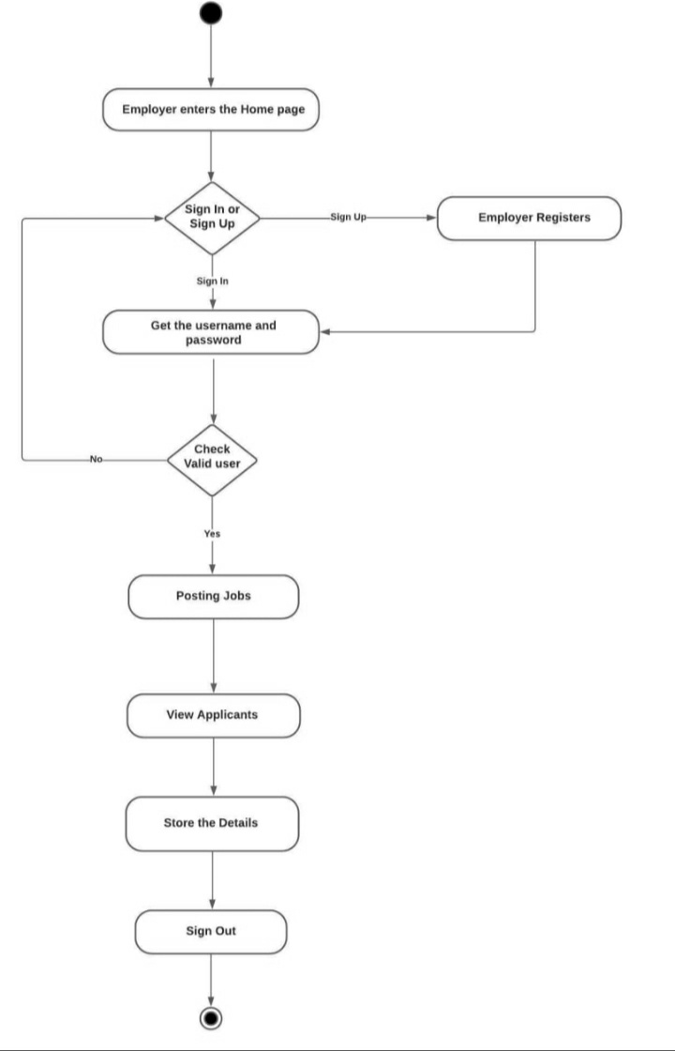
3.Activity Diagram EMPLOYERS

Slide 8
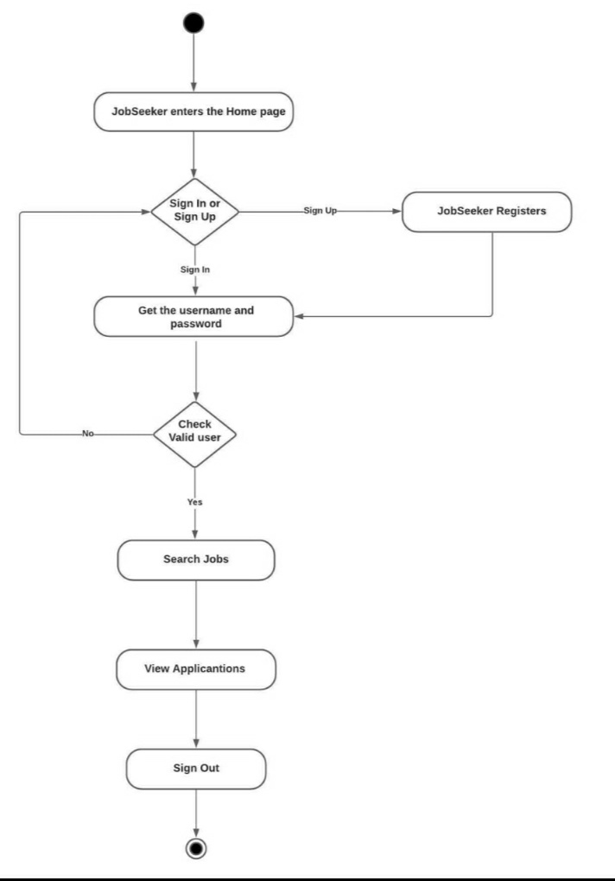
JOBSEEKERS

Slide 9
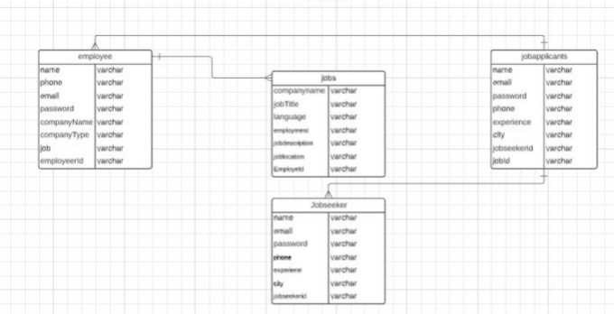
5.ER Diagram

Slide 10


